Slide 1



MICROSOFT IMAGINE CUP 25-26
SENTINAL CORE
Real-time financial truth across distributed banking systems
PRESENTED BY TEAM - LEDGERFLOW | MITWPU

Slide 2



The Problem
Modern digital transactions pass through multiple systems.
When even one system fails, records drift out of sync.
PAYMENT GATEWAY
SUCCESS
CORE BANKING SYSTEM
MISSING
MOBILE BANKING APP
SUCCESS

Slide 3




WHY THIS MATTERS
When records don’t match,
banks lose time, money, and trust.
Delayed reconciliation (detected hours or days later)
High operational cost due to manual audits
Customer disputes and regulatory compliance risk

Slide 4
Problem Validation
We validated this problem before building FraudLens.
WHO WE VALIDATED WITH
WHAT WE LEARNED
• Fintech developers
• Banking system simulations
• Academic & industry mentors
• Reconciliation is still reactive
• Issues are detected too late
• Manual resolution is expensive

Slide 5
Our Solution - Sentinal Core
Sentinal Core is a real-time transaction reconciliation engine
Live 3-way matching
Across Payment Gateway, Core Banking, and Mobile Banking
Instant mismatch detection
Detects missing, delayed, or inconsistent transactions
Automated alerts & resolution
Risk scoring with auto-mitigation where possible

Slide 6
HOW SENTINAL CORE WORKS
Event-driven | Real-time | Automated
TRANSCTION EVENTS
REAL-TIME STREAM PROCESSING
3-WAY RECONCILATION ENGINE
ALERTS AND LIVE DASHBOARD

Slide 7

Solution Architecture
Transaction Sources
(Payment Gateway | Core Banking | Mobile App)
Event Streaming Layer(Kafka / Azure Event Hubs)
Reconciliation Service
(Matching + Risk Scoring Logic)
Ledger Store
(Transaction Records)

Slide 8
Built on Microsoft Azure
  Azure Event Hubs
Real-time transaction ingestion (Kafka-compatible)
  Azure Functions
Serverless stream processing & reconciliation logic
  Azure App Service
Backend APIs and reconciliation services
  Azure Web Apps
Hosting the live dashboard
  Azure Storage / Azure SQL
Secure transaction ledger storage
  Azure Monitor
Logging, metrics, and system health
Azure services chosen for scalability, reliability, and security.

Slide 9
What Makes Us Different
Feature | ❌ The Old Way (Status Quo) | ✅ The Reconciliation Engine (Our Solution)
Speed | T+1 (Overnight) Errors detected 24 hours later. | T+0 (Real-Time) Milliseconds via Event-Driven Kafka.
Resilience | "Happy Path" Testing Systems break when real networks fail. | Built-In Chaos Engineering Active 24/7 simulation of drops & latency.
Resolution | Manual Spreadsheets Hours spent "staring and comparing." | Automated Self-Healing Algorithmic consensus voting (No human input).
Impact | High Operational Anxiety | 90% Reduction in Manual Overhead

Slide 10
Continuous Improvement Loop
Detection
Feedback
Improved Accuracy
Model & Rule Tuning
Each anomaly improves future detection and system resilience

Slide 11





Market Opportunity
Any organization processing high-volume digital transactions faces this problem.
Banks & NBFCs
Fintech platforms
Payment processors
Digital wallets & UPI apps
Reduced financial loss • Faster resolution • Improved customer trust

Slide 12
Buisness Model
Revenue Stream | Mechanism | Why It Wins
1. Subscription | Monthly Base Fee (Free / Growth / Enterprise) | Predictable MRR. "Product-Led Growth" captures devs early.
2. Usage (Scale) | Volume Overage (Micro-fee per tx > limit) | Zero CAC Growth. As they succeed, we get paid more.
3. Premium | "Resilience" Module (Chaos Engine Add-on) | High Margin. Monetizes the need for safety during peak loads.

Slide 13
Demo Readiness
Sentinal Core is fully functional and demo-ready.
✅ Live transaction streams
✅ Real-time mismatch detection
✅ Interactive dashboard & alerts
✅ End-to-end demo recorded
System is demonstrable within the demo video as required.

Slide 14
The Vision
Autonomous Finance
Phase 1 (Now): The Immune System
Phase 2 (Next): Predictive Routing
Phase 3 (Future): The Trust Protocol
Real-time detection & auto-mitigation.
AI predicts bank failures before transactions are sent.
A universal verification layer for Banks & DeFi.

Slide 15
Research & Sources
Title: Intelligent Algorithms for the Detection of Suspicious Transactions in Payment Data Management Systems Based on LSTM Neural Networks
Mukhamadiyev, A., Nazarov, F., Yarmatov, S., & Cho, J. (2025)
Link: https://doi.org/10.3390/s25216683
Title: A Deep Learning Based Hybrid Model Using LSTM and CNN Techniques for Automated Internal Fraud Detection in Banking Systems
Pillai, R. P., & Latha, D. P. P. (2025)
Link: https://www.jisem-journal.com/
Title: Adaptive Anomaly Detection in Database Transactions: Bridging Security Gaps with Reinforcement Learning
Reddy, C., Prabhagaran, S., & Vaid, A. (2025)
Link: https://doi.org/10.24018/ejai.2025.4.2.53
Title: A Suspicious Financial Transaction Detection Model Using Autoencoder and Risk-Based Approach

Slide 16
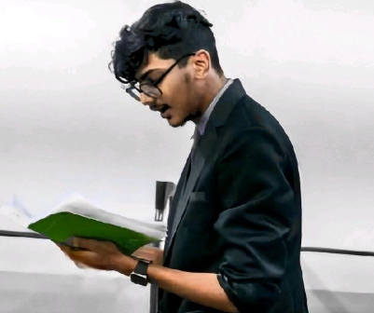

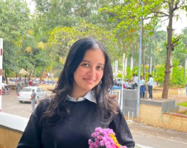

Our team
Aryan Dani
Anant Kulkarni
Himali Dandavate
Raghav Vyavahare
Leader, Architect
Backend
Model Training
Azure Microservices

Slide 17
Thank you
CONTACT US
E-mail
daniaryan212@gmail.com
Social Media
https://www.linkedin.com/in/aryandani/
Phone
+91 8668205450
Address
A-704, Victoria Garden, Kalyani Nagar, Pune, 411006

